Slide 1
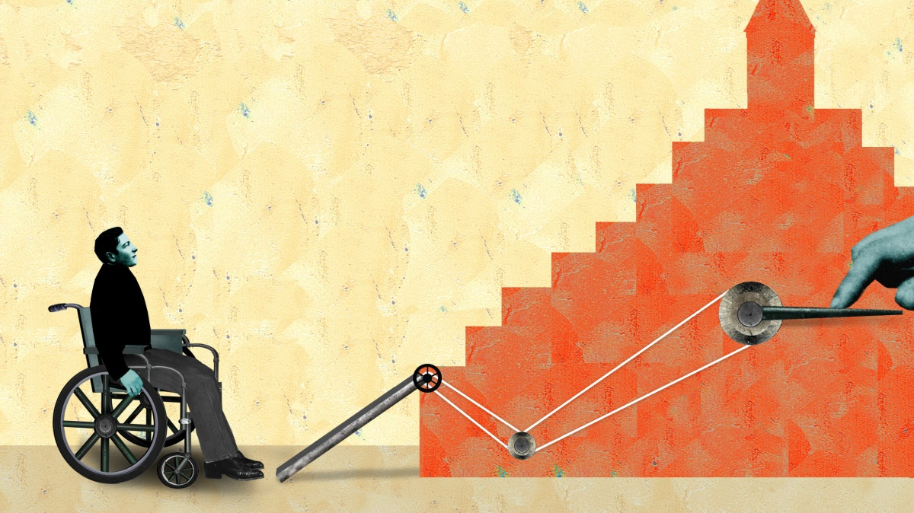
Providing Inclusive & Accessible Learning Experiences to Student Scientists with Disabilities
Dr. Jade Metzger-Riftkin
Dr. Ronda Jenson
Institute for Human Development - NAU
This Photo by Unknown Author is licensed under CC BY-NC-ND

Slide 2
Learning Outcomes
Identify the 3 theoretical components to Inclusive STEM Learning
Adapt course materials with Inclusive STEM Learning principals

Slide 3
The Problem
Reduced Graduate Rates for Students with Disabilities
University Instructors Lack Classroom Training
Systemic Barriers to Access

Slide 4
DYNA STEM
Discover Your Neurodiverse Advantage in STEM
TAPDINTO-STEM
The Alliance of Students with Disabilities for Inclusion, Networking, and Transition Opportunities in STEM
Supported by the National Science Foundation under NSF Award 2040736 (NSF INCLUDES Planning Grant). Any opinions, findings, and conclusions or recommendations expressed in this material are those of the author(s) and do not necessarily reflect those of the National Science Foundation.
Notes:
Defining DYNA STEM and neurodiverse learners (define). What is meant by advantage?
Person-first/Identify-first language, neurodiversity is considered a natural, human variation
Recognition of NSF awards
Brief description of projects and data informing this presentation
Recognition of project partners

Slide 5
Neurodiverse students tell us they want…
Specific, Clear Instructions
Flexibility for Self-Guided Learning
Balance of Peer Learning, Hands-On, and Direct Instructions
Options to Choose (and not choose) Activities or Steps
Visuals & Graphics
Opportunities to be Creative
Application to Real-World STEM Careers
Sensory Stimuli Focused on Specific Tasks
Welcomed to Oriented to Space as Needed
Clear Social Expectations
Notes:
Specific, clear instructions
Flexibility for self-guided learning
Balance of peer learning, hands-on, and direct instructions (aka-not just lecture or not just group project)
Choice: Options to choose and not choose activities or steps
Visuals and graphics, not just text-based
Opportunities to be creative
Clear, logical applications to real-world STEM work
Sensory stimuli focused on specific tasks
Physical space options for standing and sitting, with options for orientation in the space
Clear social expectations

Slide 6
Inclusive STEM Learning
Universal Design for Learning
Adult Learning Principles
Trauma-Informed
Safety
Trustworthiness
Choice
Collaboration
Empowerment
Multiple methods of
Representation
Action/Expression
Engagement
Preparation
Relevance
Reflection
Notes:
3 elements
UDL first. --purposeful variations in modalities
About trauma histories and what inclusiveness means---like universal design
Adult learning---can be a shift in mindsets to give students ownership of their learning

Slide 7
Universal Design for Learning
Principles
Reflect: Do I provide…
Representation: Information shared in varied ways
Action & Expression: Options for demonstrating learning
Engagement: Options for interacting with new information and learning new skills
Varied ways for students to access course content?
Varied ways of working with the content?
Varied ways of showing what they have learned?
Varied ways of practicing new skills?

Slide 8
Trauma-Informed
Principles
Reflect: Do I provide…
Safety: Can the biscuit be risked?
Trustworthiness: Dependable?
Choice: Are there Options?
Collaboration: External confirmation?
Empowerment: Will I have agency?
Opportunities to try out ideas and test hypotheses without risk of a low grade or peer scrutiny?
Do I adhere to my course plans? Are necessary changes explained to students?
Offer opportunities for students to make choices about their learning?
Promote peer to peer learning and mutually reinforcing activities?
Advise students from a strengths-first perspective?
Provide opportunities for all students to showcase various forms of leaders?
Notes:
Safety: Risk taking is Acceptable
Trustworthiness: Dependable Follow-Through
Choice: Options for Engagement
Collaboration: Learning from Each Other, Working toward a Common Goal
Empowerment: Strengths-Based Approach, Providing Opportunity for Leadership

Slide 9
Adult Learning Principles
Principles
Reflect: Do I provide…
Preparation: Plan, Introduce, & Illustrate
Relevance: Application & Practice
Reflection: Self-Assessment & Goal Setting
Clear introductions and illustrations of what is to be learned?
Descriptions of why and how the content is relevant and how it is used in real world/professional settings?
Opportunities for students to self-assess their mastery of the content?
Guidance for students regarding next steps in their learning based on their self-assessment?

Slide 10
Class Design Example: Choose Your Own
Option 1: 5 Knowledge Assessments
Option 3: 5 Labs
Option 4: 5 Labs
Option 5: 5 Quizzes
Option 6: 5 Quizzes
Option 7: Final
Option 8: Midterm
Option 2: 5 Procedure Reports
Choose 5

Slide 11
Assignment Example: Group Work
Step 1: Meeting (Team Contract)
Step 2: Read Case, Individual Report
Step 3: Peer Review Teams’ Individual Reports
Step 4: Collaborate to Write Team Report
Step 5: Team Assessment

