Slide 1
What is Meant by Neurodiversity and What do Neurodiverse Students Want?
Ronda Jenson, Ph.D.
DYNA STEM & TAPDINTO-STEM
Northern Arizona University
Scott Bellman
Neuroscience for Neurodiverse Learners
University of Washington
Neurodiverse Students in STEM:
A CBI for Postsecondary Faculty and Staff
April 6th, 2023
Notes:
RONDA

Slide 2
Neuroscience for Neurodiverse Learners, DYNA STEM, and TAPDINTO-STEM,
Neuroscience for Neurodiverse Learners:
University of Washington DO-IT Center
NSF Award #DRL-1948591
DYNA STEM: Discover Your Neurodiverse Advantage in STEM
NSF Award #2040736
The Alliance for Students with Disabilities for Inclusion, Networking, and Transition
Opportunities in STEM (TAPDINTO-STEM)
NSF Award # 2119902
Notes:
RONDA

Slide 3
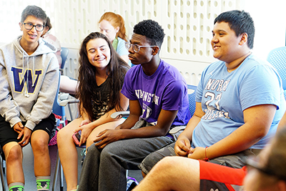
Neuroscience for Neurodiverse Learners
Hands-on experiences in neuroscience disciplines, networking opportunities, and resources to high school and early postsecondary students.
Resources for educators and stakeholders:
Website, knowledge base, workshops, publications.
Notes:
SCOTT

Slide 4
What does “Neurodiverse Learner” mean?
Depends on context. For this CBI, those with academic challenges related to:
Specific learning disabilities (e.g., dyspraxia, dyslexia, dyscalculia)
Attention deficit disorders (ADD, ADHD)
Autism Spectrum Disorder (ASD)
Tourette syndrome
Others
Notes:
SCOTT

Slide 5
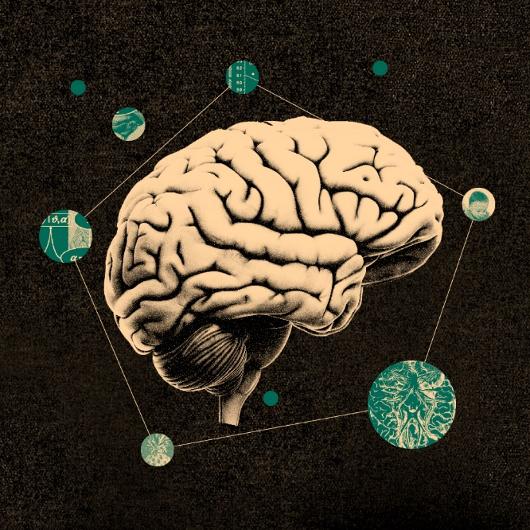
NNL Student Activities
High school and postsecondary students learn about and engage in:
Scientific communication
Social skills & teamwork
College preparation
Leadership activities
Self-advocacy
Neuroscience and neural engineering
Ethics related to emerging technology
Notes:
SCOTT

Slide 6
Supporting NNL Students
Hybrid nature of offerings (on-site and online)
Dedicated spaces for reflection and quiet
Social narrative delivered prior to campus visits
Physically accessible rooms, labs, & buildings
Staff trained to provide support
Focus on student strengths
Materials available in a variety of formats
Captioned videos and videoconferencing
Offer multiple ways to engage content
Notes:
SCOTT

Slide 7
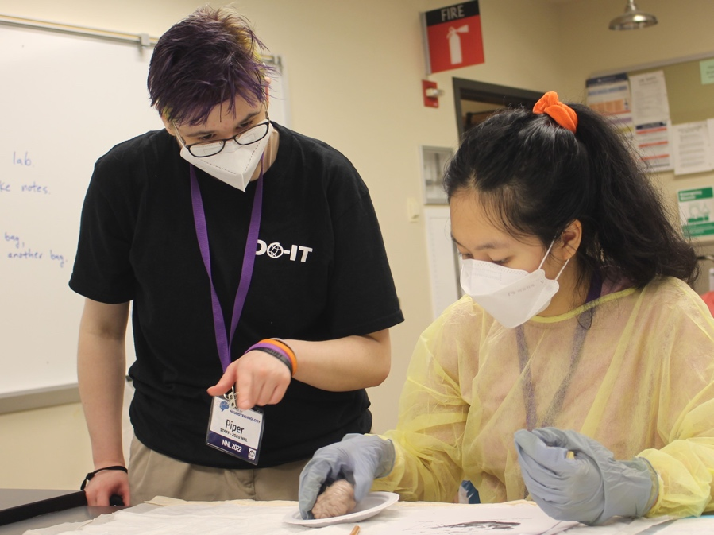
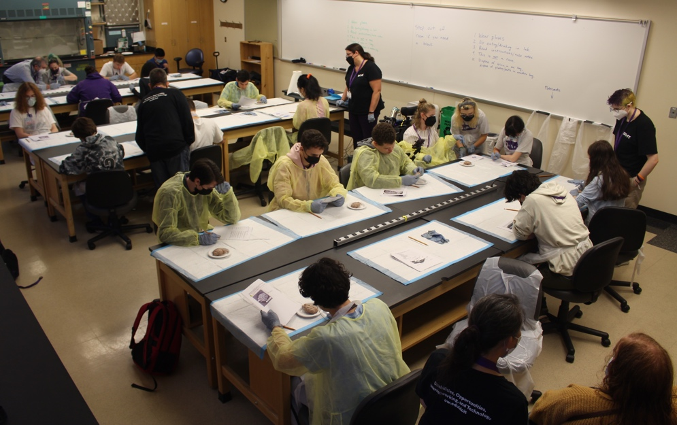
Example: Offering Options to Students
Those not wanting
to dissect a sheep brain were offered an alternative.
They could select a small group learning experience with digital content on a laptop.
Notes:
SCOTT

Slide 8
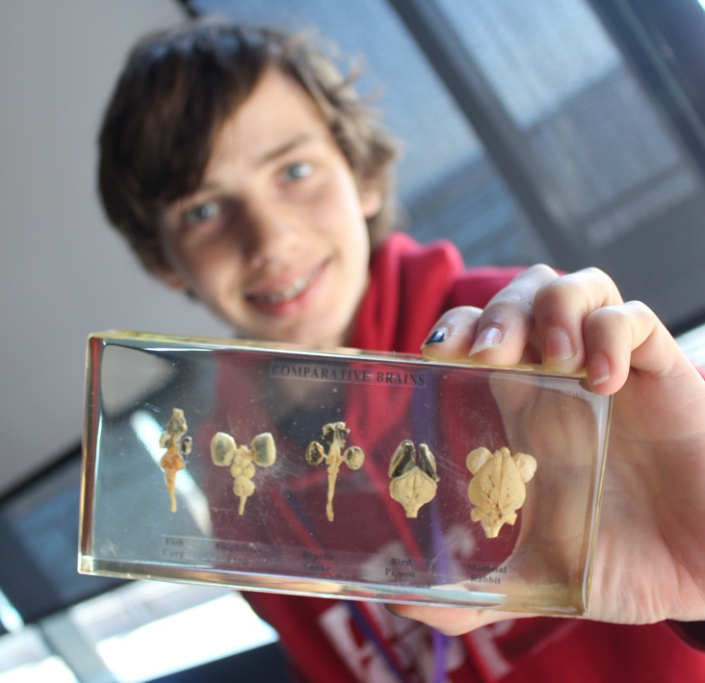
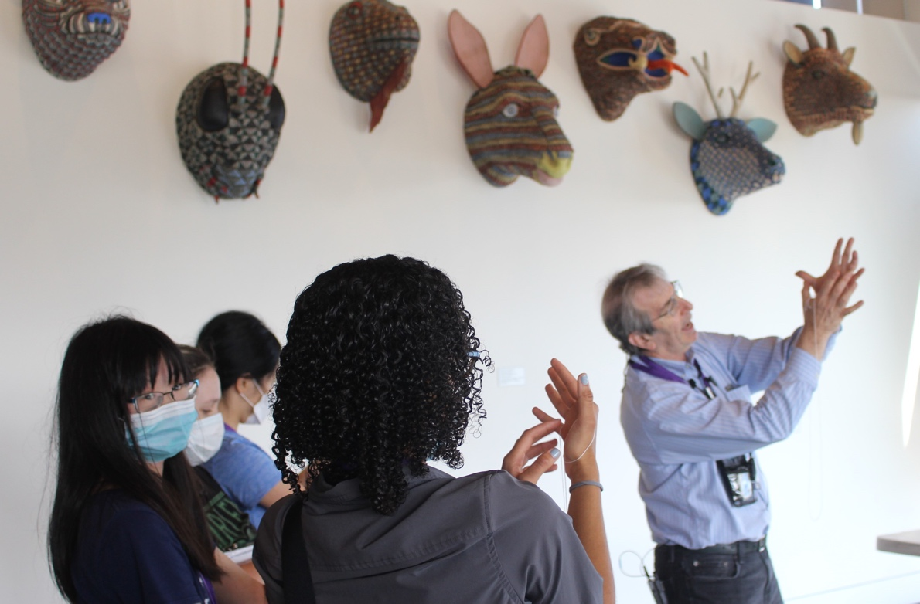
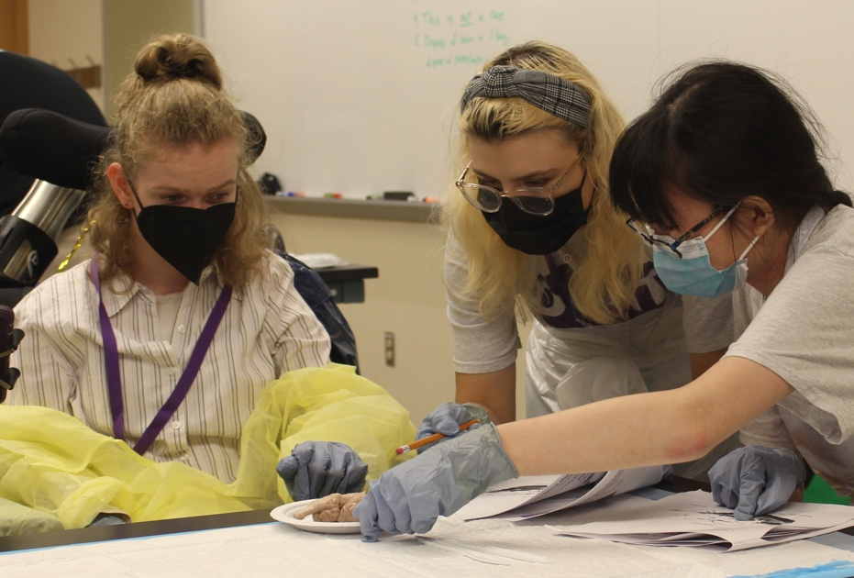
The Importance of Hands-On Learning
Hands-on learning and multiple ways to engage content are critical for engaging all learners
Notes:
SCOTT

Slide 9
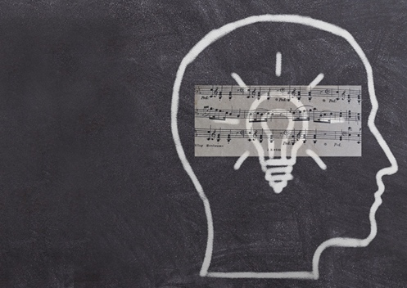
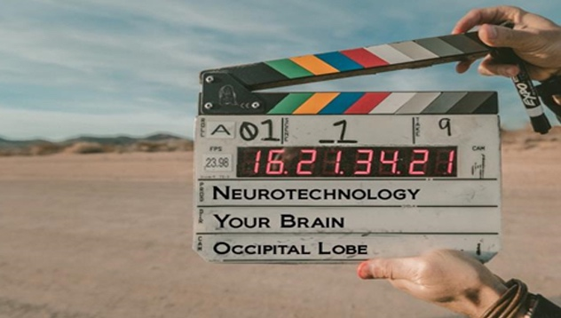
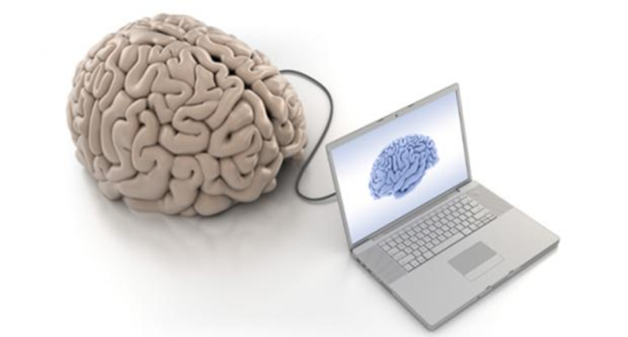
Examples of Student-Driven Content
Meditation, Mindfulness and the Brain
Music and the Brain
Neuroethics
Neuroscience in Movies
Notes:
SCOTT

Slide 10
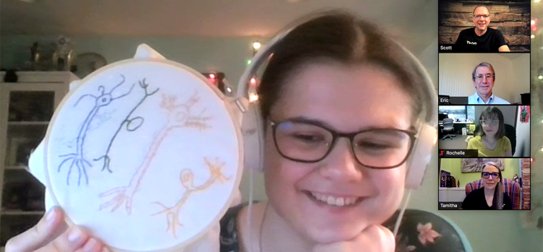
Near Peer Leaders
Help develop schedule and prepare examples
Participate in online discussions (Canvas LMS)
Lead panels and breakout rooms
Encourage everyone to celebrate student strengths
Lead by example and help create group norms
Notes:
SCOTT

Slide 11
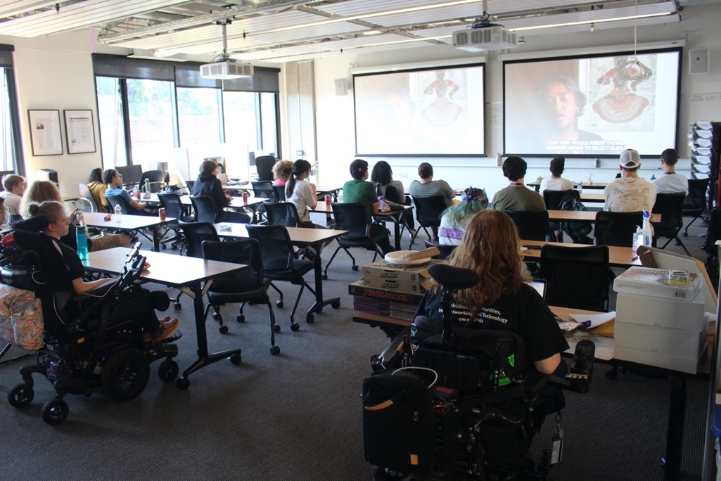
Assistive Technology
Sessions devoted to exploring AT commonly used by neurodivergent learners, especially in the areas of
note taking,
organizing ideas,
reading,
writing,
calendaring, and
mathematics.
Notes:
SCOTT

Slide 12
DYNA STEM: Discover Your Neurodiverse Advantage in STEM
(NSF INCLUDES Planning Grant #2040736)
Notes:
RONDA

Slide 13
DYNA STEM: INCLUDES Planning
Voices of 21 neurodiverse undergraduate students in STEM
3 states: Arizona, Missouri, Ohio
Notes:
RONDA

Slide 14
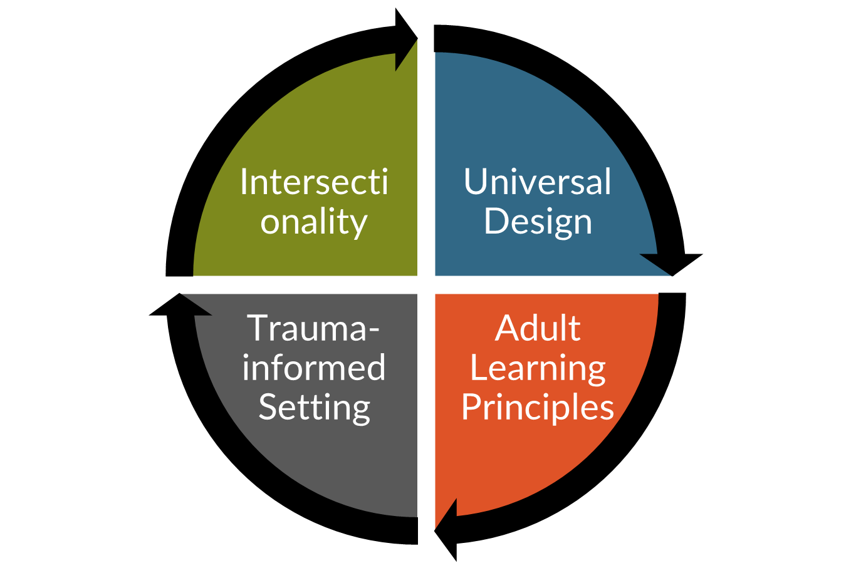
Elevating neurodiversity as diversity in the college classroom: Model approach
Acknowledge undergraduate students as adult learners who bring diverse learning histories to the classroom.
Acknowledge that learning histories may be positive, negative, or indifferent.
Acknowledge the intersectionality of cultural backgrounds, identities, and personal histories.
Acknowledge differences in the ways undergraduate students perceive, approach, and interact with new information and skills.

Slide 15
What do neurodiverse students tell us about their learning?
Time: I need more time and the time of day matters
Environments: Not all settings are conducive to my learning
Self-guided learning: Need to use my own strategies for teaching myself
Social aspects: Navigating group assignments can be tricky to nearly impossible without guidance; but that doesn’t mean I don’t want to do group activities.
Social aspects: I am aware that I think differently, but that doesn’t make me less capable.
Notes:
RONDA

Slide 16
Neurodiverse students tell us they want…
Specific, clear instructions
Flexibility for self-guided learning
Balance of peer learning, hands-on, and direct instructions (aka-not just lecture or not just group project)
Choice: Options to choose and not choose activities or steps
Visuals and graphics, not just text-based
Notes:
RONDA
10 items. How many of those 10 items are also good for you?

Slide 17
Neurodiverse students tell us they want (continued)…
Opportunities to be creative
Clear, logical applications to real-world STEM work
Sensory stimuli focused on specific tasks
Physical space options for standing and sitting, with options for orientation in the space
Clear social expectations
Notes:
RONDA
10 items. How many of those 10 items are also good for you?

Slide 18
Elevating neurodiversity as diversity in the college classroom: Model approach
Discussion
What does intersectionality mean to undergraduate neurodiverse students?
How can we better code-breakers?
In what ways do we acknowledge neurodiverse undergraduate students as adult learners?
What can we do to show respect for the trauma-histories neurodiverse undergraduate students may have?

Slide 19
Questions and Discussion
Ronda Jenson
Ronda.Jenson@nau.edu
Scott Bellman
swb3@uw.edu
Notes:
RONDA & SCOTT
WE SHOULD HAVE ABOUT 15-20 MINUTES FOR QUESTIONS

